Slide 1
Pre-Management Evolution
(1750-1890)

Slide 2
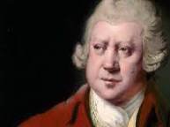
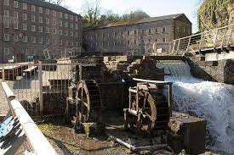
Richard Arkwright
Captains Of The Industry
Designed motors which are operated by water pressure,
applied for the patent in 1769.
(1732-1792)
Quality and quantity improved by 3 times.
In 1771 he establishes the cromford mill, which produces cotton, yarn.

Slide 3
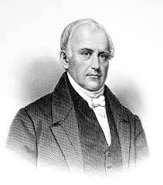
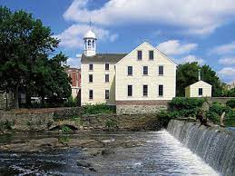
Samuel Slater: American hero or British traitor?
(1768-1835)
At age of 14 his father died.
Began working as apprenticeship with Jedidiah Strutt at his cotton mill at Belper.
At that time US was the biggest exporter of cotton but it lacked in technology.
Britain knew this and passed laws in 1774 banning the textile workers from traveling to America.
In 1789,Samuel left his home and headed up to US by ship, Disguised as a farmer.
With him was the secret to the water powered spinning machines.
In 1790 he established a cotton mill on the Blackstone river in Rhode island.
Thanks to slater, by 1835 America was producing £80m worth cotton a year, while just £2m in 1790.

Slide 4
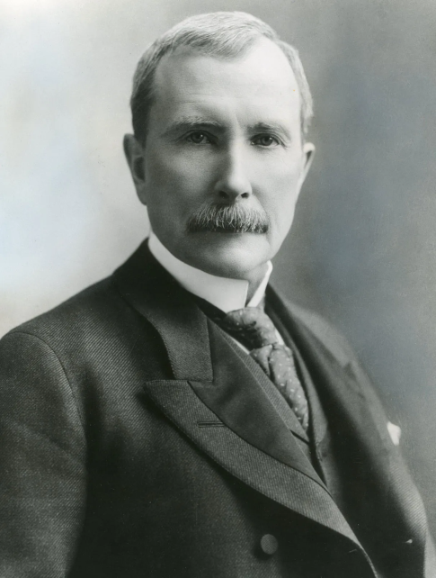
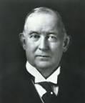
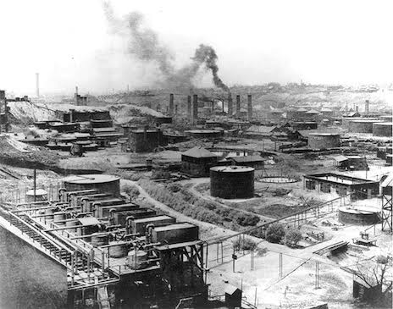
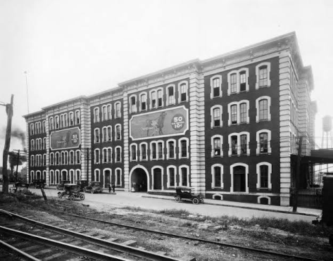
John D. Rockefeller 2. James B. Duke
(1839-1937)
( 1856-1925 )
Established Standard Oil company.
Established American tobacco company
Produces over 90% of oil in US.
40% market share in us cigarette market.

Slide 5
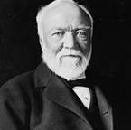
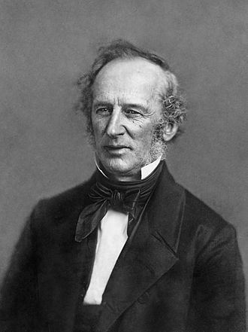
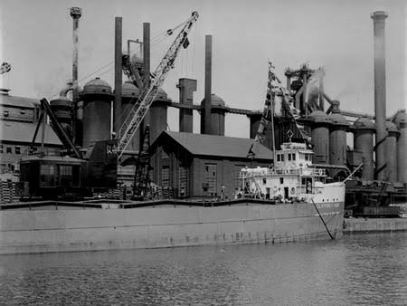
3. Andrew Carnegie 4. Cornelius Vanderbilt
(1835-1919)
(1794-1877)
Established American steel company.
Established shipping and railroad tycoon.
Contributed society by opening various schools,collages,hospitals,churches.
The first rail service provider between New York and Chicago.

Slide 6
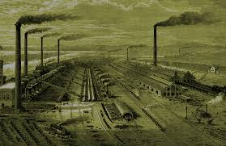
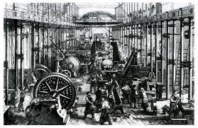
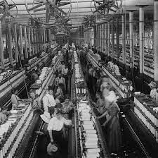
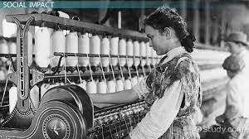
Industrial Revolution
Steam engines and Electricity were invented.
Jobs increased drastically.
(1760-1840)

Slide 7
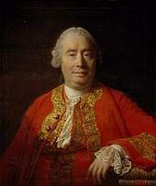
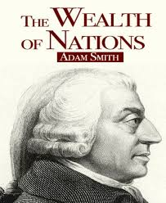
Theory Of Economics
Adam Smith
(1723-1790)
Father of Economics
Popular for his book, "The Wealth of Nations“ published in 1776.
Wealth is created through productive labor.
The Concept of Division Of Labor was Devised.
Theory of economics was published in 1759.

Slide 8
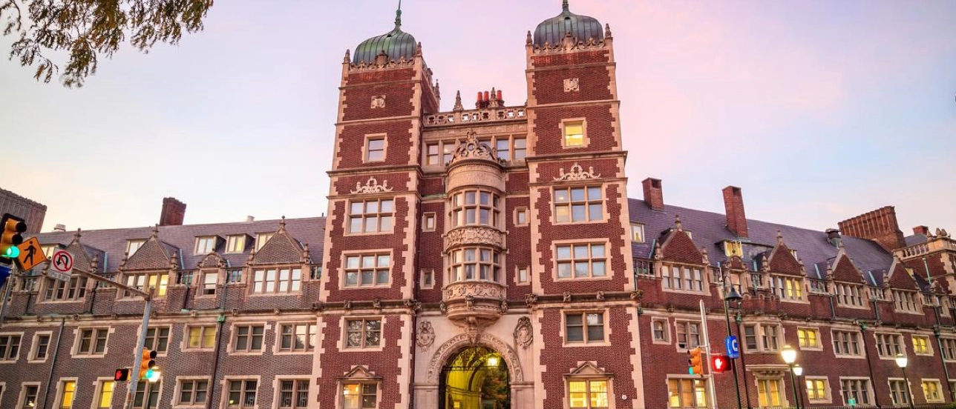
The First Business School - Wharton Business School
Established by - Joseph Wharton.
Set up at Pennsylvania in 1818.
Recognized as world first business school.

Slide 9
Factors For Emergence Of Management
Technological factors.
Modernization.
The rights and responsibilities of employees changed.
Management evidences can be witnessed from economic theories.
The above factors, lead to the emergence of management as a practice in industry and discipline in education.

Slide 10
1st Era The Rise Of Management
(1890-1940)

Slide 11
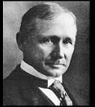
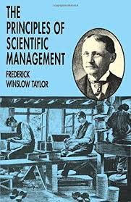

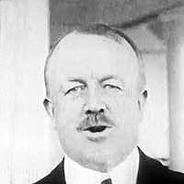
Frederick W. Taylor Frank Gilbreth
(1856-1915)
(1868-1924)
Father of Scientific Management.
Simplification of Work Theorem in 1917.
Developed the Fair Day Work Theory, In 1910.
Eastern Rate Case
Mastermind behind the clock invention.

Slide 12
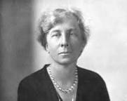

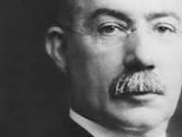
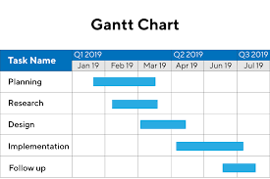
Lillian Gilbreth Henry Gantt
(1878-1972)
(1861-1919)
She Enhanced the quality of workers.
Invented Gantt Chart in mid 1890s.
Extended and completed the work of Frank Gilbreth.
Improvised efficiency of work.
Mother of Modern Management.

Slide 13
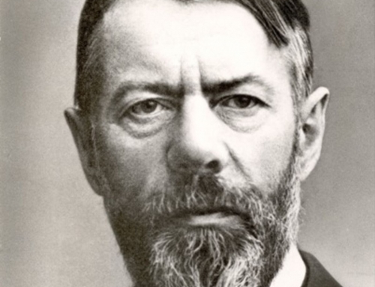

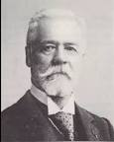
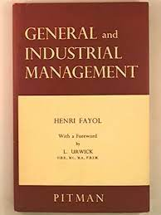
Max Weber Henri Fayol
(1864-1920)
(1841-1925)
German Sociologist who Worked for removing bureaucracy,
Introduced 14 principle of management &
In year 1930.
5 principle of managers in 1916.

Slide 14
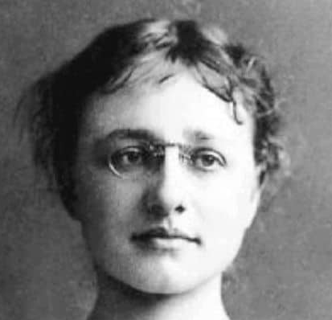
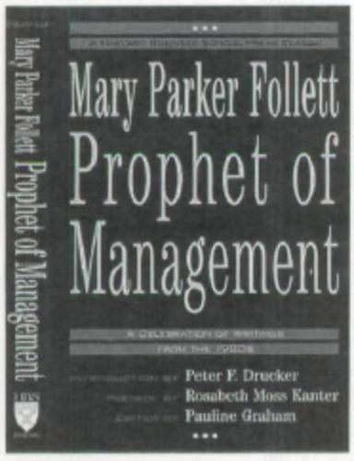
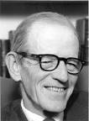

Mary Parker Follet Elton Mayo
(1868-1933)
(1880-1949)
Mother of Management.
Recognized teamwork and focused on human problems
In industrial civilization.
Ascertained Integration theory in 1925.
Pioneer in the study of interpersonal relation and personal management.
Invented Hawthorne studies in 1932.

Slide 15
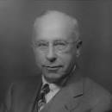
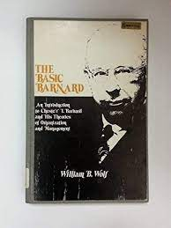
Chester luring Barnard
(1886-1961)
Worked on theory to improve effectiveness and efficiency,
aroused in 1938.
Known for the function of the executive
Empowered workers.

Slide 16
2nd Era Expansion of Management
(1950-2000)

Slide 17
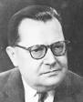

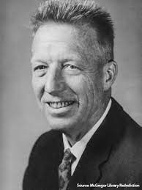
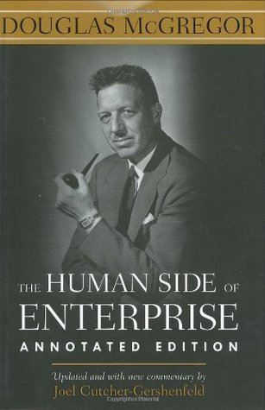

Ludwing Von Bertalanfly Douglas Mc Gregor
(1901-1972)
(1906-1964)
Biologist.
Concocted theory X and Y.
Published in 1960.
MIT Slogan School Of Management.
Improvised General Theory in 1951.

Slide 18
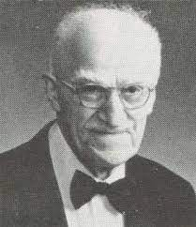
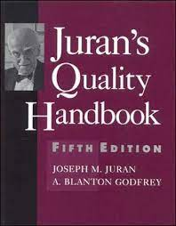
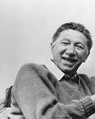
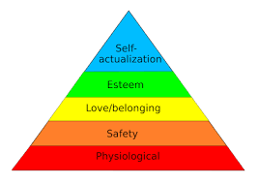
Joseph Juran Abraham Maslow
(1904-2008)
(1907-1970)
Developed Juran Trilogy
Universal way of thinking about quality.
Quality planning.
Quality control.
Quality improvement.
Established Juran Institute in 1979.
Developed Pyramid Model in 1943.
Developed harakeke of needs.

Slide 19
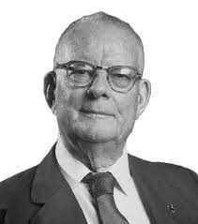
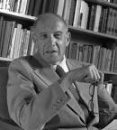

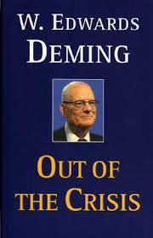
Edward Demming Peter Drucker
(1900-1993)
(1909-2005)
Came across with prediction based theory in 1950.
Created SMART model & MBO model in 1955 at US.
Influence people to work with joy/interest,
Published at MIT press.

Slide 20
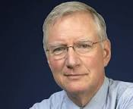
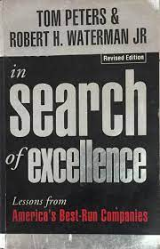
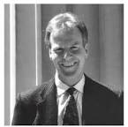
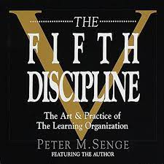
Tom peters Peter Senge
(1942)
(1947)
Management Guru of 20th century.
Simulated Senge Model in 1990.
Presented the McKinsey 7s frame work in 1980.
Author of (fifth discipline).
Published theory on leadership quality in 1982 at US.

Slide 21
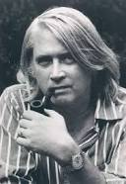
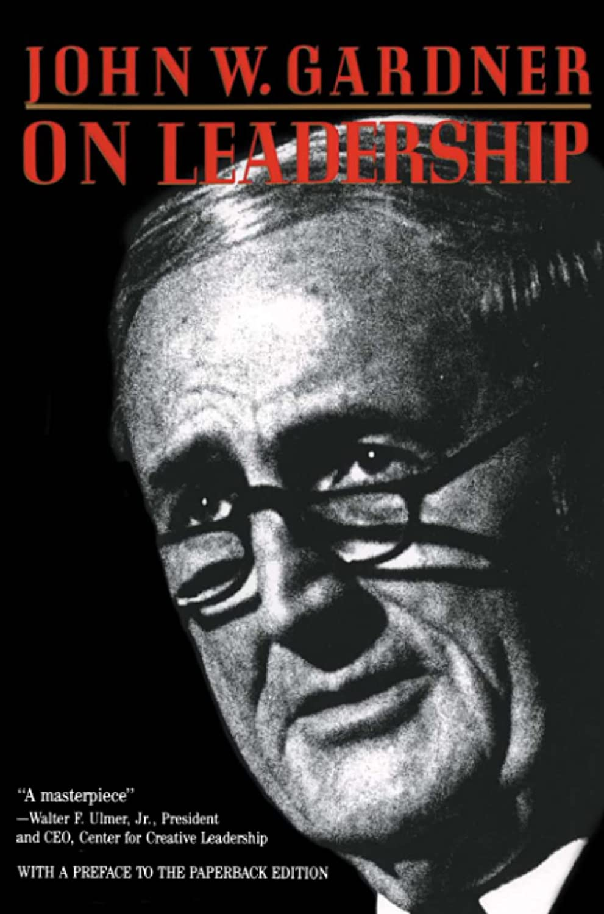
John Gardner
(1933-1982)
Author of John W. Gardner on Leadership
Published in 1993.
Agenda---People should follow leaders.

Slide 22
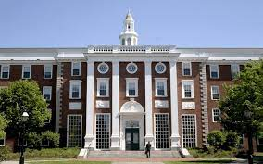
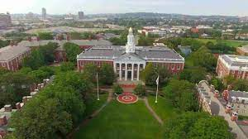
Harvard Business School
Established by John Harvard, in 1908 at Boston (US).
HBS was developed to spread management education.

Slide 23
References
The Economics times
Harvard Business Review
https://www.timetoast.com/timelines/history-of-management-theory-practice
https://www.researchgate.net/publication/307760441_The_Evolution_of_Management_Theories_A_Literature_Review
https://www.greatmanagers.com.au/management-theory-origin/
https://www.businessmanagementideas.com/management/theories-management/classification-of-management-theories-4-schools-of-thought/4679

Slide 24




HISTORY OF MANAGEMENT
{ANCIENT ERA}

Slide 25


ANCIENT EGYPT
Built 2550 to 2490 BC
Constructed by Pharaoh Khufu in 2550 BC, Khafre built the second pyramid in 2520BC and the third pyramid by Pharoah Menakure in 2490 BC
Buildings were made with limestone, mud and bricks and stone blocks were moved by sledges

Slide 26


HARRAPAN CIVILIZATION
The Harappan civilisation lasted from c. 2600–1900 BCE
It was located in Indus river valley. Its two large cities were Harappa and Mohenjo-daro
The entire civilization was built by the Aryans, The Harappans used standardized sun-baked bricks to build city walls,

Slide 27


ROMAN CATHOLIC CHURCH
Founded on of 16 July 1054, in Holyland
The Catholic Church began with Jesus Christ his teachings and were built by his disciples
Christ created the Catholic Church to give God “praise, reverence, and service; to give him glory.”

Slide 28


ROADS DEVELOPED BY ROMANS
The Ancient Roman roads were founded in 312 B.C.
The roads begun by the censor Appius Claudius Caecus in 312 bce from Rome to Tarentum
Roman roads provided efficient means of movement of armies, official, civilians, inland carriage

Slide 29


BABYLONIAN EMPIRE
Babylonian was founded around 2300 B.C.
Founded By the ancient Akkadian-speaking people of southern Mesopotami
Hammurabi conquered neighboring city-states, brought much of southern and central Mesopotamia

Slide 30


ANCIENT MACEDONIA ARMY
Macedonia, a small kingdom in northern Greece, established a growing empire from 359 B.C. to 323 B.C.
Alexander III commonly known as Alexander the Great, was the king of the ancient Greek kingdom of Macedon.
Alexander invited military families from throughout Greece to settle on lands he had conquered from his enemies, thus army of Macedonia was among the greatest military forces of the ancient era

Slide 31
REFERENCES
https://www.thehindu.com/news/national/who-built-the-indus-valley-civilisation/article61842855.ece
https://fhsu.pressbooks.pub/management/chapter/the-history-of-management/
https://www.britannica.com/place/Babylon-ancient-city-Mesopotamia-Asia
https://www.worldhistory.org/article/676/the-army-of-alexander-the-great

